Slide 1



Constructing Modern Women’s Leadership Identities in the Arabian Gulf: Synthesising Roles from Culture, Tradition and Modernisation
Dr. Eugenie Samier and Ms. Amal Al-Gallaf

Slide 2
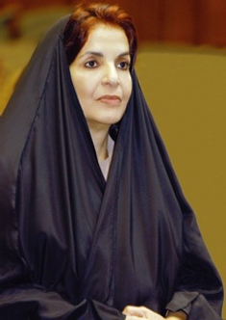
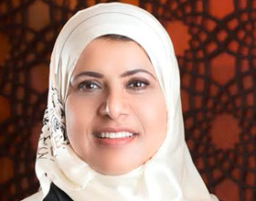
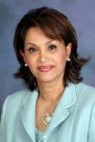
Introduction
HRH Princess Sabeeka bint Ibrahim Al Khalifa
Dr. Jawaher Al Mudhahki
Dr. Nada Hafadh

Slide 3
Gaps in the literature
Lack of documentation:
More women in senior organisational & community positions
Roles in reshaping social institutions
Provision of role models & mentoring
Analysis:
Most ‘Western’ leadership models biased towards other societal/cultural values & arrangements

Slide 4
Proliferation of partial leadership Theories (representative)
Women’s/Feminist (Kanter, Gemmill & Oakley;
Carli & Eagly) 1970s+
Contingency (Fiedler, House) 1960s/70s
Theory X & Y (McGregor) 1960s
Situational (Stogdill, Hersey & Blanchard) 1950s/70s
Power Relations (French & Raven) 1950s
Motivation Theory (Herzberg) 1950s
Behavioural Theory (Stogdill, Katz) 1940/60s
Needs Theories (Maslow) 1940s
Styles (laissez-faire to autocratic) (Lewin) 1940s
Trait Theory (Mann) 1920s

Slide 5
Leadership Theories Cont.
Leadership as an Art (Depree) 1980s
Distributed (Brown & Hosking) 1980s
Organisational Culture (Schein) 1980s
Theory Z (Japanese/US Blend) (Ouchi) 1980s
Personality/Disorders (Kets de Vries) 1980s+
Servant Leadership (Greenleaf) 1970s
Charismatic (House, Shamir, Conger & Kanungo) 1970s/1990s
Transformational/Full Range (Bass & Avolio) 1980s/90s
Normative Decision-making (Vroom & Yetton) 1970s
Transactional/Transforming (Burns) 1970s
Manager/Leader Distinction (Bennis) 1970s

Slide 6
Newer Theories
Toxic (Kellerman, Kets de Vries, Lipman-Blumen) 1990s/2000s
Cross-cultural (Hofstede, Trompenaars, GLOBE) 1990s+
Adaptive Change Model (Heifetz) 1990s+
Relational/Identity Model (Komives) 1990s
Spiritual (Fairholm, Fry) 1990s+
Creative (Parnes-Osborn) 1990s
Exemplary Model (Kouzes & Posner) 1990s
Leading Change (Kotter) 1990s
Authentic (Bennis) 1980s
Tasks/Group (Gardner) 1980s
Visionary (Sashkin) 1980s

Slide 7
Turn-of-the-Century
Diversity (Eagly, Chin) 2010s
Strategic (Finkelstein, Boal) 2000s
Ideological (Strange & Mumford) 2000s
Social Network (Balkundi & Kilduff) 2000s
Cognitive Abilities (Lord, Hall, Mumford) 2000s
Ethical/Moral (Ciulla) 2000s
E-Leadership/Virtual teams (Zigurs) 2000s
Team-based (Hill) 2000s
Shared (Pearce, Conger) 1990s/2000s
Follower Studies (Kellerman, Shamir) 2000s
Complexity (Uhl-Bien, Marion & McKelvey) 2000s
Authentic (Luthans, Avolio, Gardner) 2000s

Slide 8

Leadership in Islam
(Eman ElKaleh & E. A. Samier, 2013)
Tolerance
Honesty
Compassion
Patience
Servant
Justice
Guardian
Empathy
Kindness (ihsan)
Shura / Consultation
Builds on work of Ali 2005, Beeken & Badawi 1999

Slide 9
Limitations of Western Models
(GLOBE studies)
1: Leader-Centred – conflicts where priority is egalitarianism in power
2: Male-Dominated (US) – conflicts where masculine ideals & traits don’t dominate
3: Universal Traits - leader self-confidence less valued in collectivist cultures where harmony more important
4: Quantifiable Performance - short-term bias conflicts with long-term oriented cultures
5: Individualistic – individual achievements, merit & rewards conflicts with majority of world (collectivist) with emphasis on group cohesion

Slide 10
Approach to Proposed Model
Exploratory theory-building
Social constructivist, critical & postcolonial theories (comprehensive): individual+group+organisational+societal levels integrated
Interdisciplinary
Criteria: 1) comprehensive/contextualised; 2) culturally sensitive

Slide 11
Interdependent levels of analysis: influences on identity & leadership Role formation
historical, social & cultural contextualisation
individual level through social identity and agency-cultural identity formation theory
interpersonal interactions
social institutions through organisational social constructivism

Slide 12
1. Contextual Forces
External
Local
Past colonial influences
Modernisation influences (industrialisation, economics, administrative models, etc.)
Globalisation influences (media, culture, education, etc.)
Internationalisation (e.g., travel)
Geo-political strategic centre
Multiculturation
History
Cultural & religious traditions
Traditional roles, social structures
Traditional social institutions (e.g., legal)

Slide 13
Contrast in Values: Gulf Core Values
(Fox, Mourtada-Sabbah & Al-Mutawa 2006)
priority of family and its dignity and honour
religion providing ultimate meaning and morality
transactions focused on the influence of kin and friends
hospitality, generosity and sharing
loyalty to family and friends & patience and mercy
pride of and respect for heritage and tradition
family councils to discuss issue
justice, honesty, and compassion for the down-trodden and honest transactions to avoid disgracing one’s family name
show of strength, courage & defence of one’s family, land and rights
respect for authority, patriarchy, gender segregation and deference to family/clan/tribal patriarch demands
modesty in dress

Slide 14
American core Values
(Fox, Mourtada-Sabbah & Al-Mutawa 2006)
secular, materialist, and individualist
equal opportunity
achievement and success
material comfort; activity and work
practicality and efficiency
progress
science
democracy and free enterprise
freedom

Slide 15
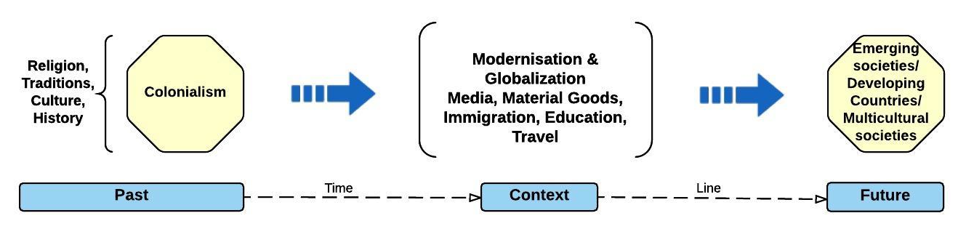
Level 1 Context

Slide 16
2. The individual Level: Social Identity Theory (Tajfel 1982; Côté and Levine 2002)
Group membership:
choosing the group
identifying with its norms & attitudes
embedding self-concept in it
Integration of personality, social interaction & social structures:
guided by cultural and religious norms

Slide 17
Côté & Levine (2002)

Slide 18
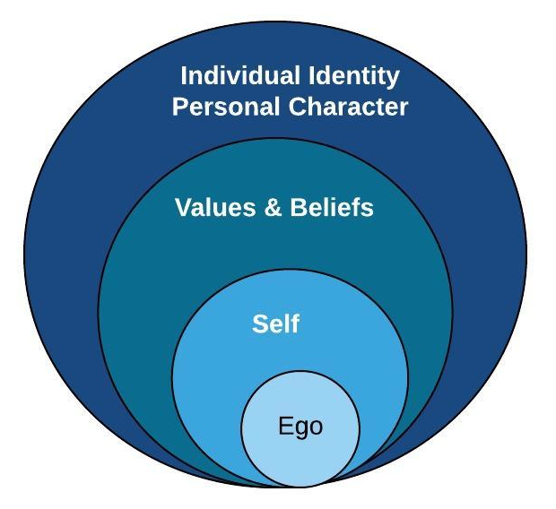
Level 2: The individual Level

Slide 19
3. Interpersonal Interactions
(Blumer 1969; Goffman 1969)
Symbolic interaction (Blumer): meaningful use of symbols & objects in one’s world in an interpretive process (embedded in family structure, tribal affiliations, status group norms)
Social interaction (Goffman): ritual performance of roles informed by values & cultural norms
Both operate through networks, role models & mentors

Slide 20
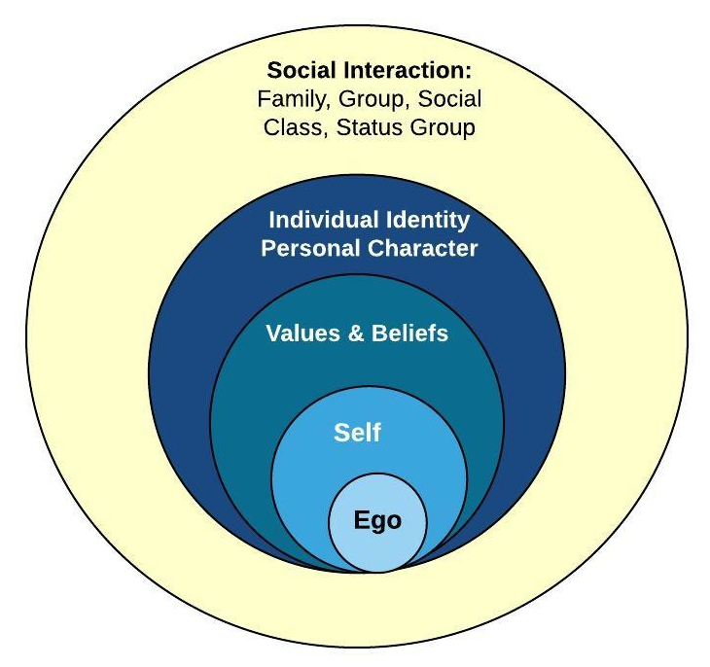
Level 3: Interpersonal Interaction

Slide 21
4. Organisational & social institutions
(Gergen 1994)
Social constructivism: org’s & social institutions form out of people’s experiences, values, religious and cultural norms producing org’l realities in interaction
Communal rationality (not ‘objective’ rationality)
Produce realities (not observe ‘objective’ reality)
Language is part of the construction (not means of representing or reflecting in ‘scientistic’ models)
Multiculturation of meaning & plurality of realities (not ‘narrative of progress’ in scientistic tradition)

Slide 22
Construction of Women’s Leadership Roles
On institution and organisation level 2 domains providing for women in leadership roles:
  state level - laws, policies & programmes support (educ, training) & appointment of women for leadership in formal and informal ways
  organisation level - formal policies, informal practices, supportive org culture

Slide 23
Conclusion: Another path?
Fox, Mourtada-Sabbah & Al-Mutawa (2006): “The Arab Gulf region: Traditionalism globalized or globalization traditionalized?”
conceptualising leadership identity formation for women that conserves cultural & religious norms and values while modernising

Slide 24
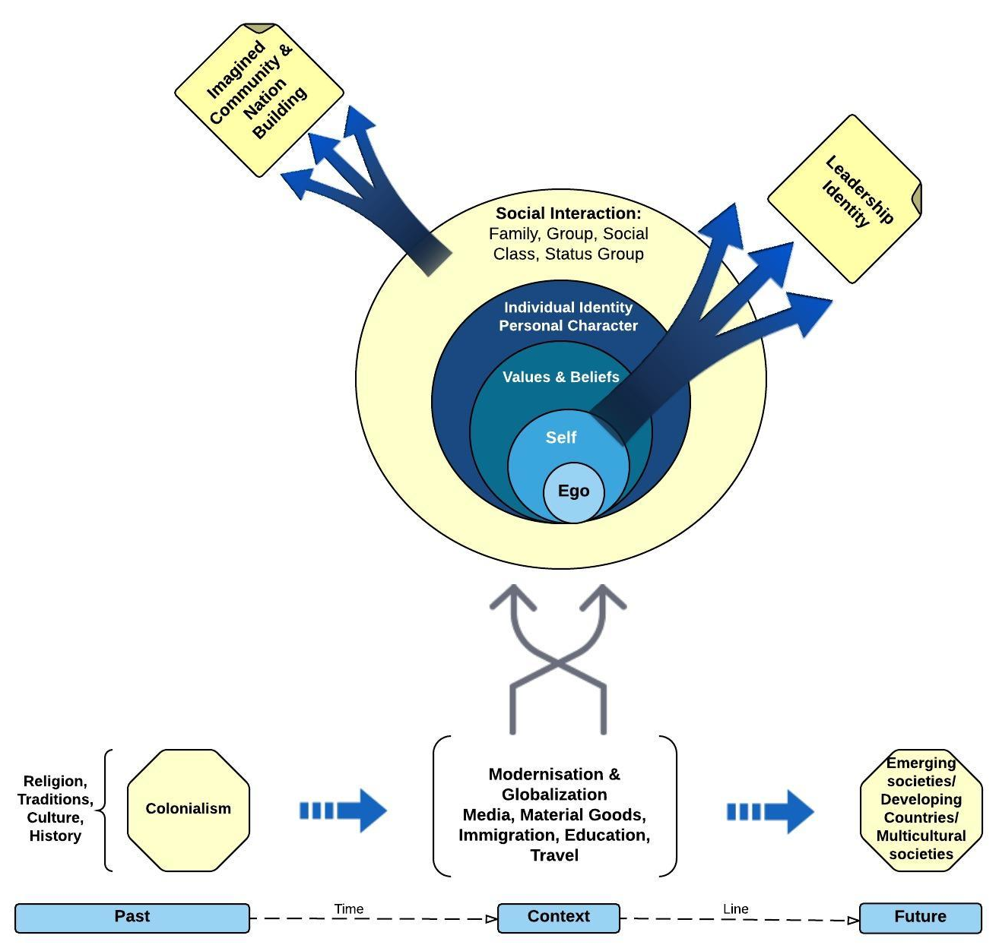

Slide 25
Implications
Theoretical: leadership identity formation incorporating context, psycho-social models, symbolic/social interactionism & social constructivist organisation
Research: stronger role for interpretive, critical theory & postcolonial approaches - focus on meaning construction (hermeneutics), experiential dimensions (phenomenology), cultural practices (ethnography & historiography); AND indigenous research methods
Professional development: models and training including authentic cultural factors (not extracted ‘objective’ variables)
Graduate programmes: include international material AND local and regional knowledge; grounded in comparative and cross-cultural studies.

Slide 26

Any Questions?

